Slide 1
SQLite

Slide 2
SQLite Home Page https://www.sqlite.org/index.html
zero configuration, standalone, relational database engine that is designed to be embedded directly into application
database instances are documents, self-contained within single file, allowing easy transport and simple setup
Latest Release: Version 3.43.1 (2023-09-11)

Slide 3
SQLite
free, public-domain software package that provides relational database management system, or RDBMS: to store user-defined records in large tables; can process complex query commands
is lightweight when it comes to setup complexity, administrative overhead, and resource usage
Multi-Platform: Android, Linux, Mac OS X, Windows

Slide 4
SQLite
Serverless: does not require a separate server process or system to operate; SQLite library (.dll files in Windows) accesses its storage files directly
Zero Configuration: no setup; creating SQLite database instance is as easy as opening a file
Cross-Platform: entire database instance resides in single cross-platform file, requiring no administration
Self-Contained: entire database system integrates directly into host application.
Small Runtime Footprint: default build is less than megabyte of code and requires only few megabytes of memory

Slide 5
chances are, if you have a smartphone, it has several SQLite databases stored on it

Slide 6
SQLite Products
SQLite core - actual database engine and public API; core can be built into static or dynamic library, or it can be built in directly to application
sqlite3 command-line tool - allows developer to issue interactive SQL commands to SQLite core; useful for developing and debugging queries

Slide 7
SQLite Products
Tcl extension - outside of native C API, these Tcl bindings are the only official programming interface supported directly by SQLite team
SQLite analyzer tool - used to analyze database files; displays statistics about database file size, fragmentation, available free space, used to determine if it is appropriate to VACUUM (repack and defragment)

Slide 8
Mac OS X and most Linux distributions include a copy of sqlite3 utility as part of operating system
Install SQLite on Windows
  download precompiled binaries from Windows section
  unzip above zipped files in folder: sqlite3.def, sqlite3.dll and sqlite3.exe files
  put sqlite3.def, sqlite3.dll in C:\Windows\System32
    Windows looks for DLLs in several directories, though the most common is System32 folder, located at C:\Windows\System32

Slide 9
Back-End database server: database engine – SQLite, PostGreSQL, Microsoft SQL Server, Oracle, MySQL, …
Front-End tool: to work the database …

Slide 10
DBeaver Community | Free Universal Database Tool https://dbeaver.io/
free, cross-platform database tool for developers, database administrators, analysts, and everyone working with data
supports all popular SQL databases like MySQL, MariaDB, PostgreSQL, SQLite, Apache Family, and more …

Slide 11
SQL Server Management Studio (SSMS) - SQL Server Management Studio (SSMS) | Microsoft
canonical
build by Microsoft, work only with Microsoft SQL Server
best tool for Microsoft SQL Server

Slide 12
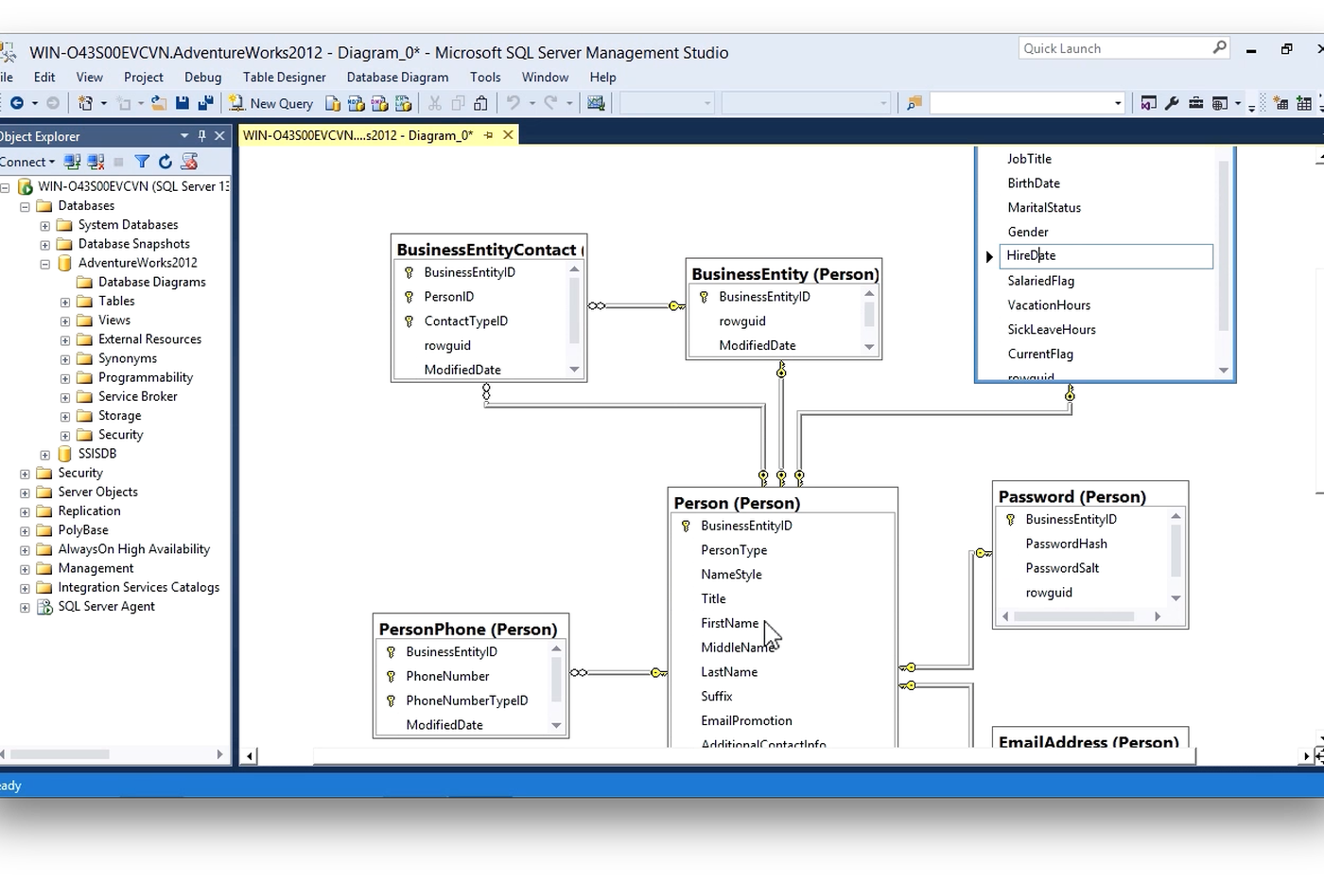

Slide 13
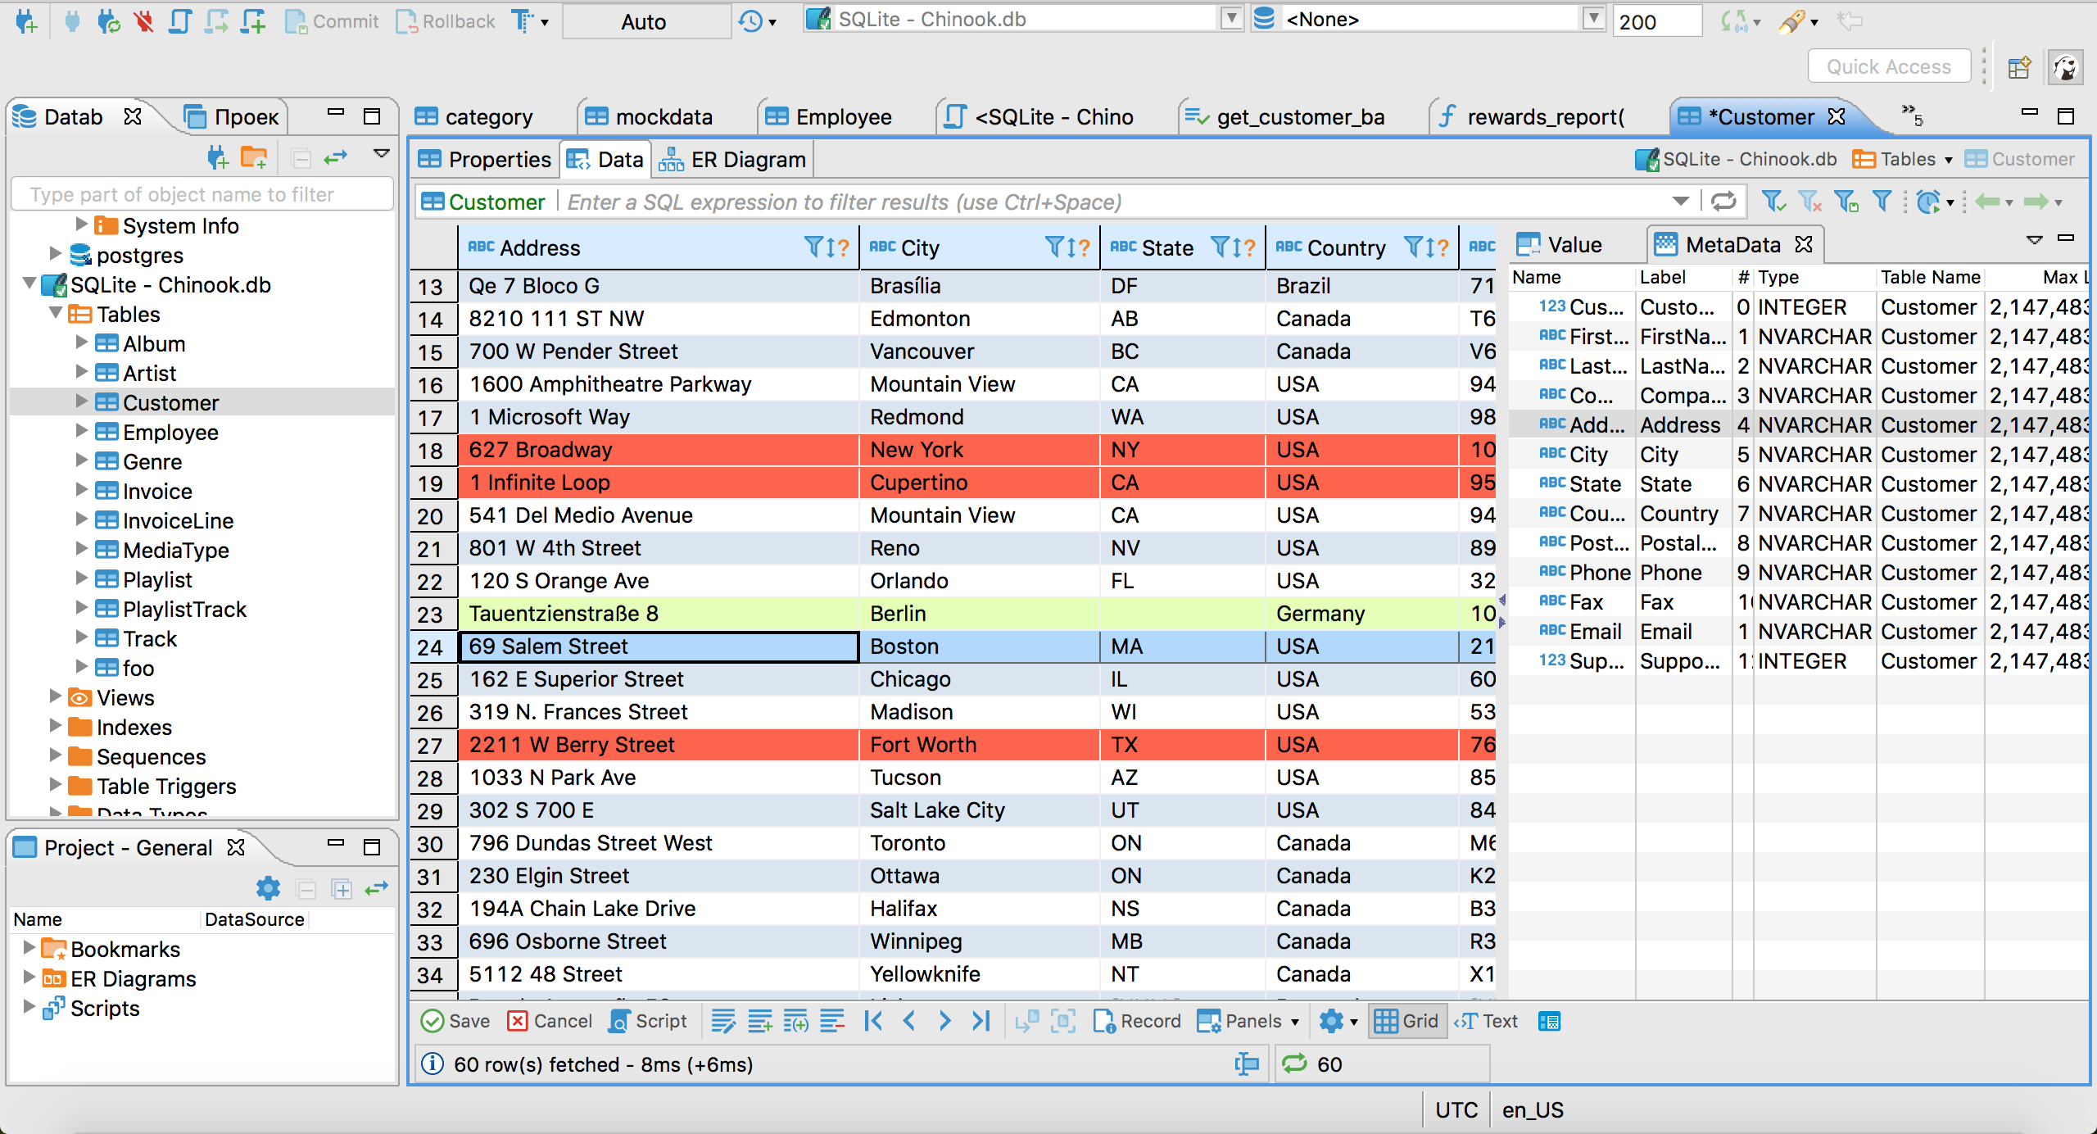

Slide 14
It's as easy as 1, 2, C
Back-End database server: database engine – SQLite, PostGreSQL, Microsoft SQL Server, Oracle, MySQL, …
Front-End tool: to work the database …
DataBase

Slide 15
DataBase
SQLite Sample Database And Its Diagram (in PDF format) (sqlitetutorial.net) https://www.sqlitetutorial.net/sqlite-sample-database/

Slide 16
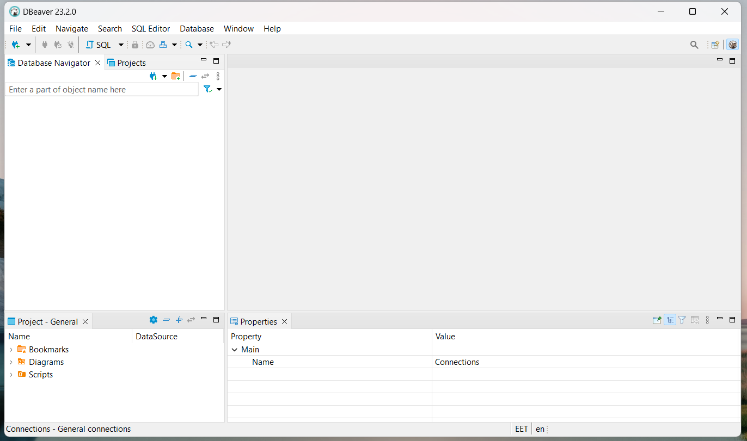

Slide 17
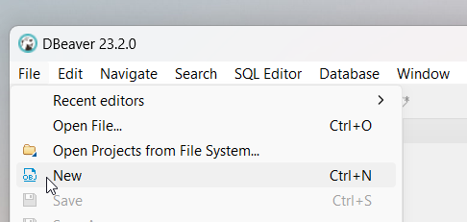
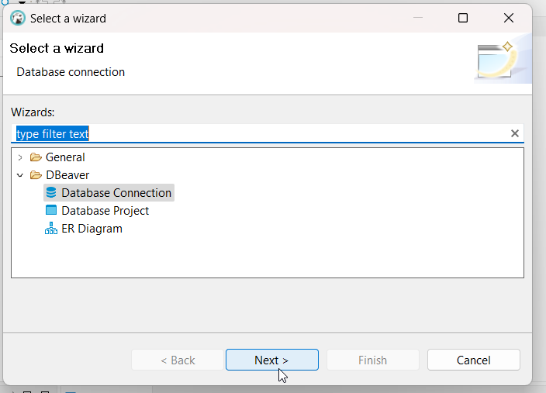

Slide 18
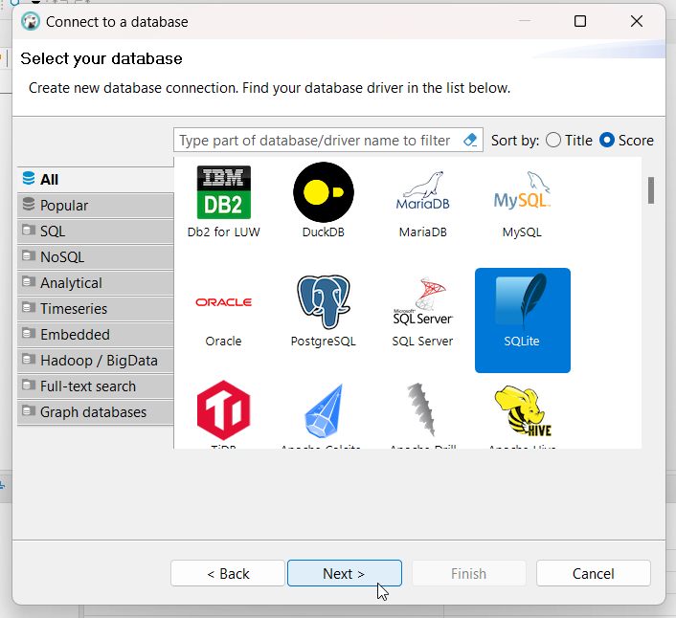

Slide 19
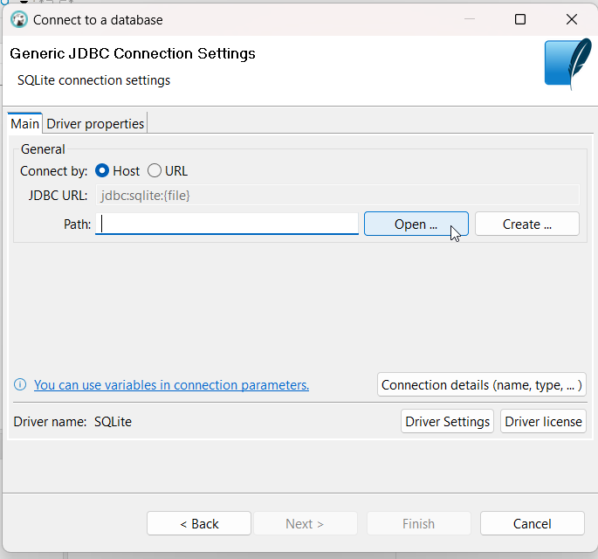
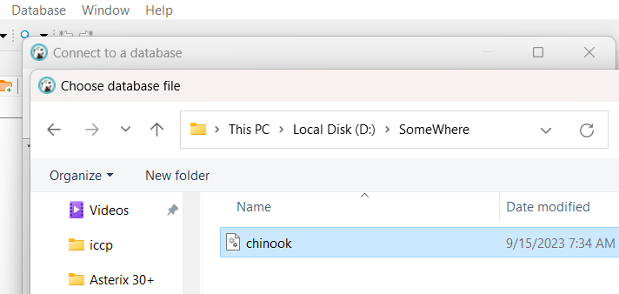

Slide 20
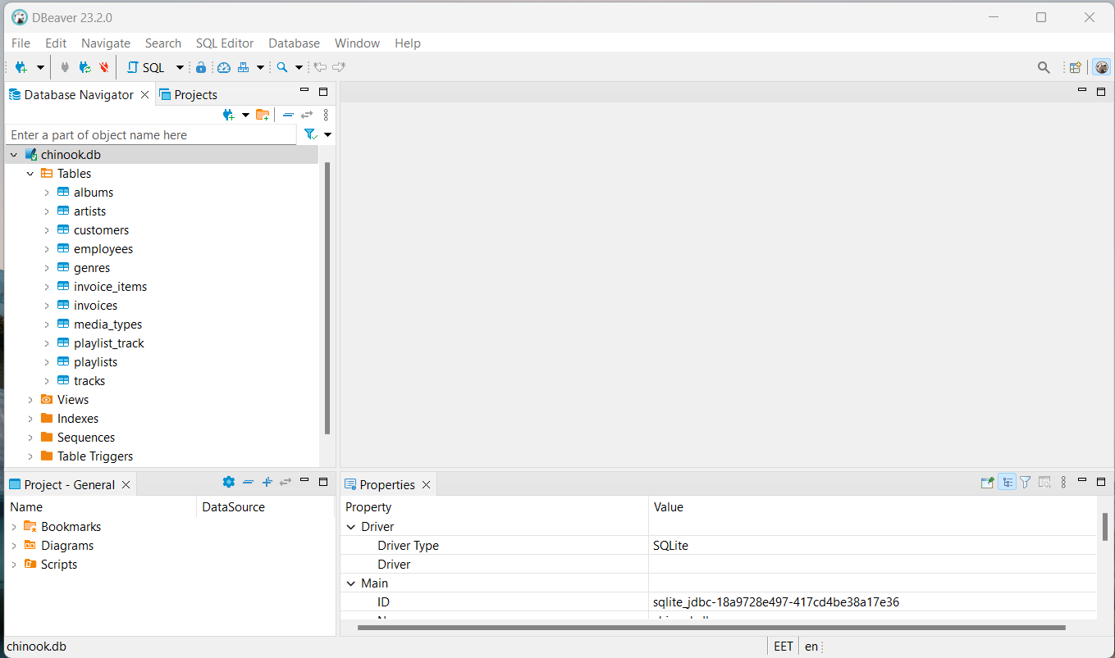

Slide 21
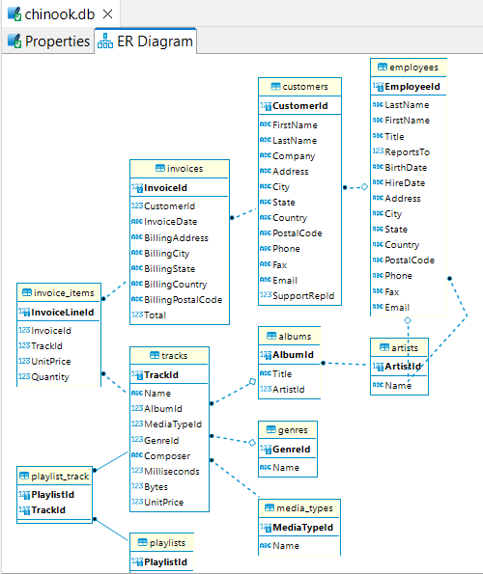
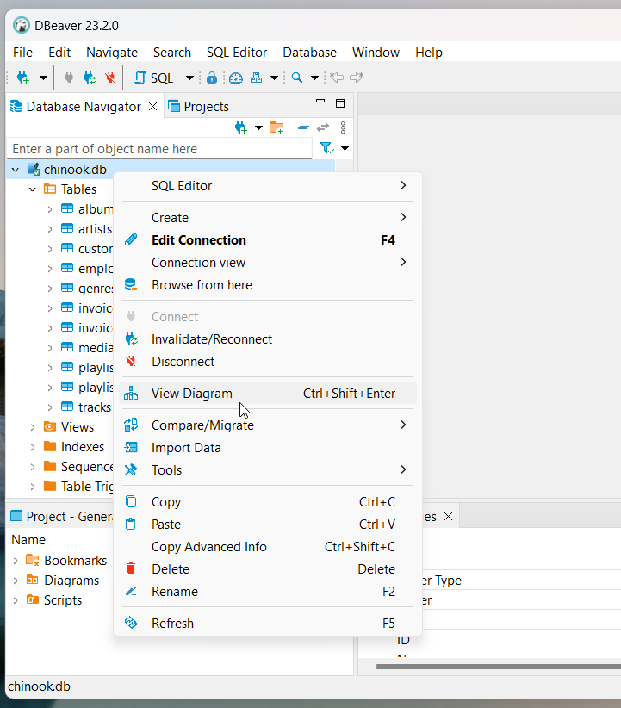

Slide 22
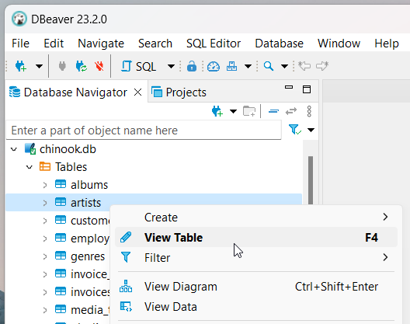

Slide 23
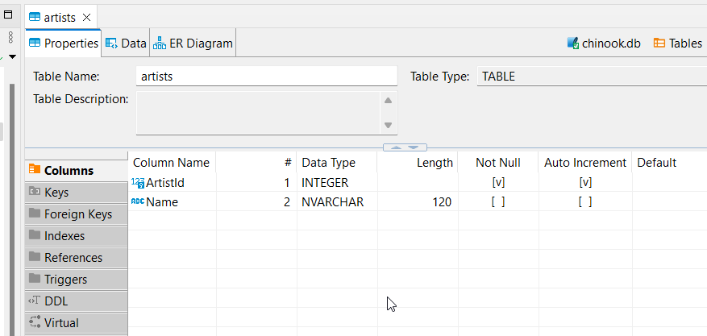

Slide 24
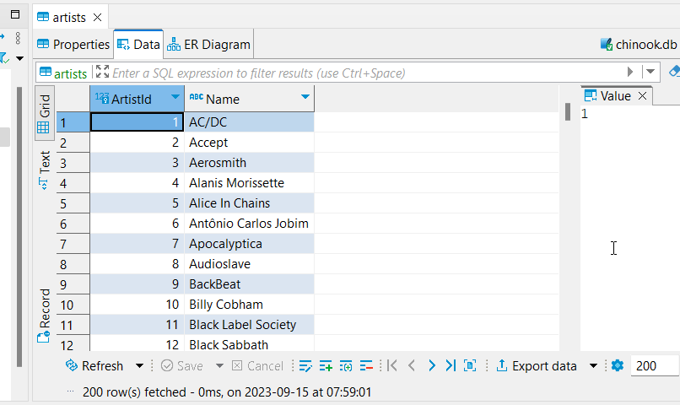

Slide 25

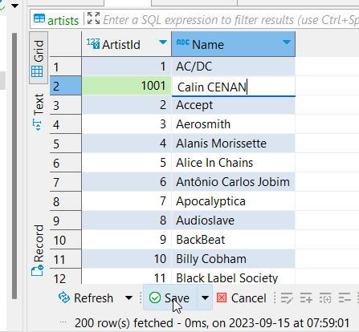
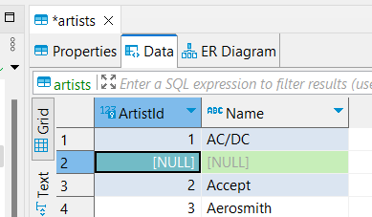

Slide 26
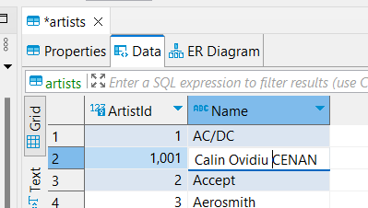

Slide 27


Slide 28
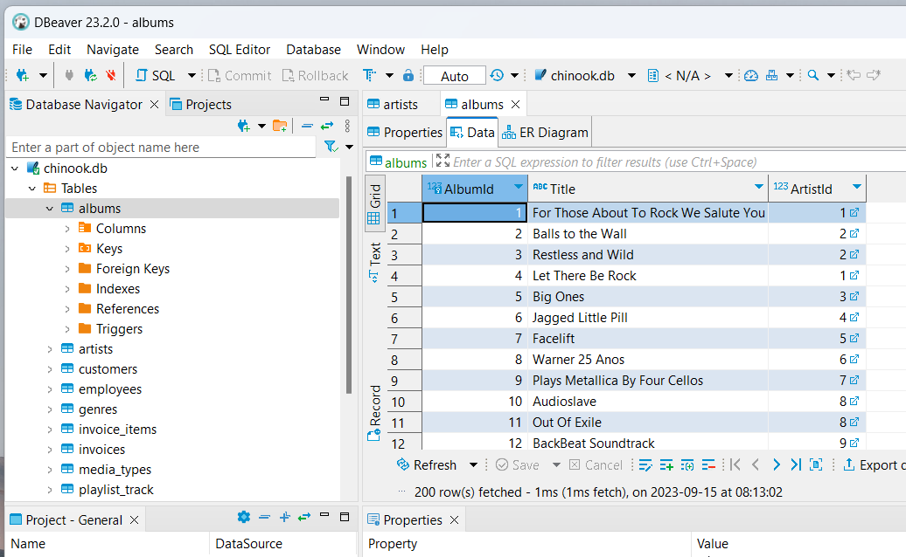

Slide 29
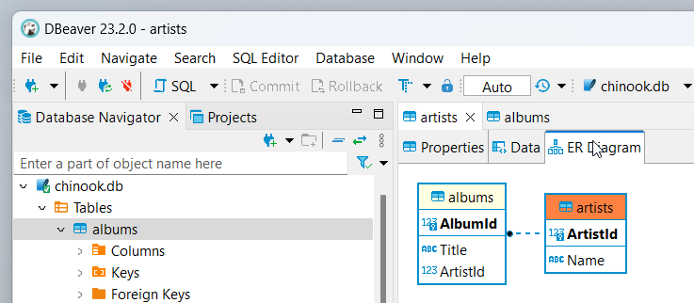
Constraint
Delete from artists: 1001, Calin – O.K.
Delete from artists: 1, AC/DC – Not O.K. – it is referred in albums: 1, For Those About To Rock We Salute You, 1

Slide 30
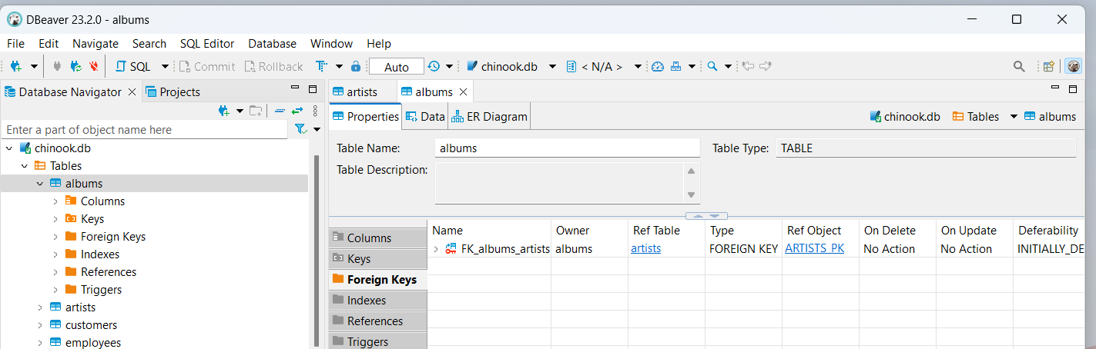

Slide 31
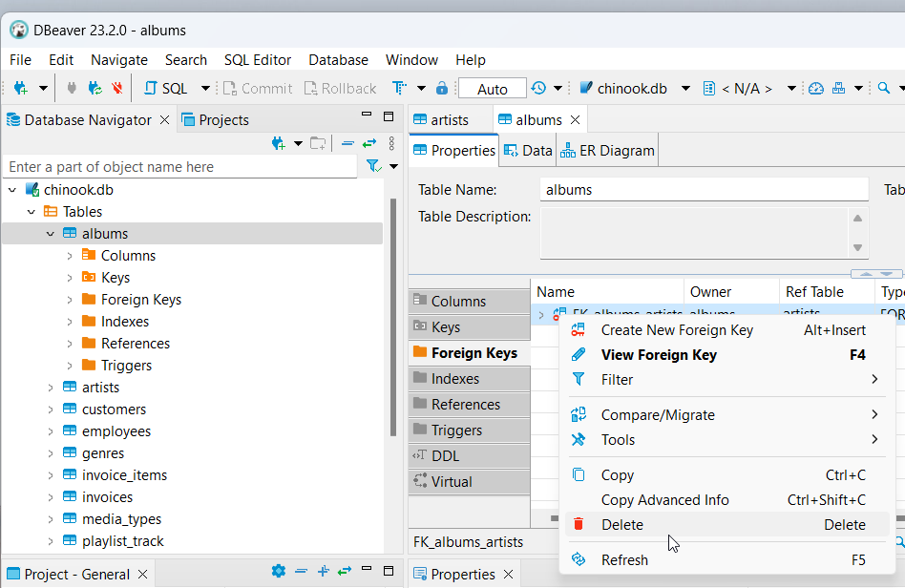

Slide 32
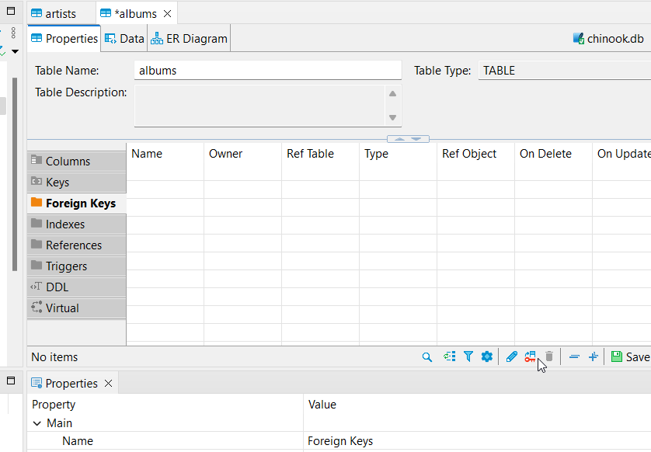
Create Foreign Key

Slide 33
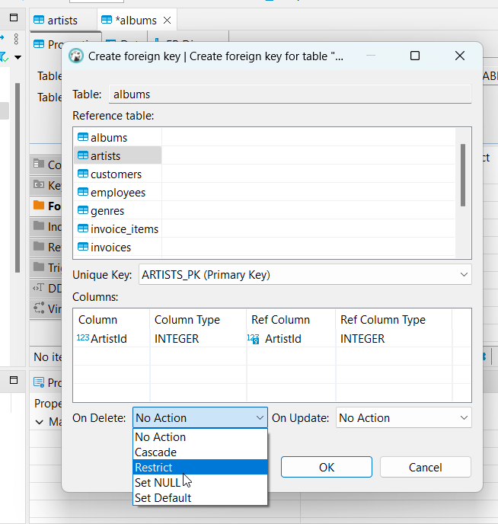

Slide 34
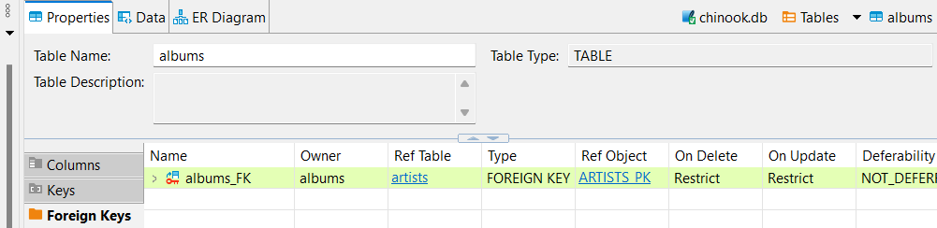

Slide 35
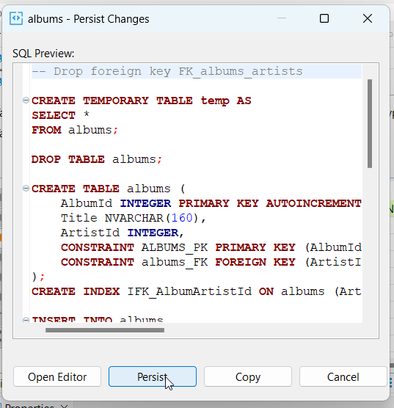
Constraint Create

Slide 36
Persisted to Database
all interface between human users or application programs
Structured Query Language SQL
database

Slide 37
SQLite Foreign Key Support https://www.sqlite.org/foreignkeys.html
sqlite> PRAGMA foreign_keys = ON;

Slide 38
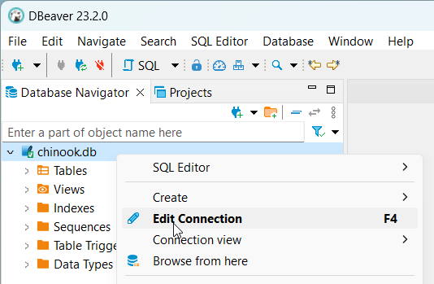
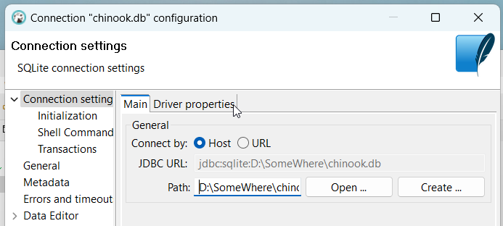

Slide 39
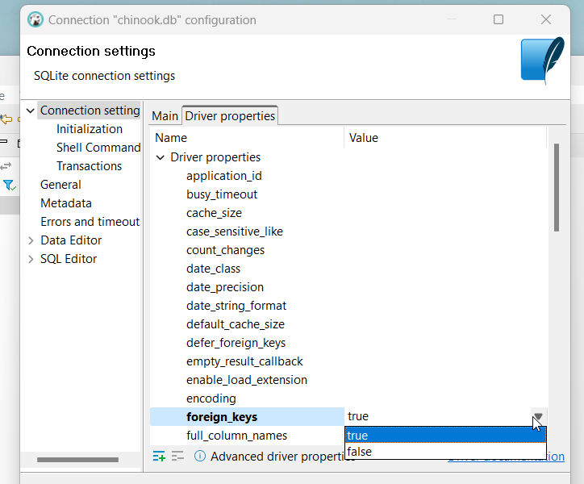

Slide 40
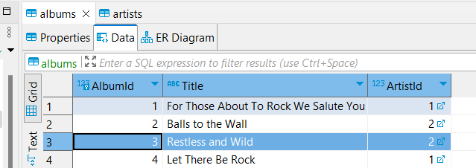

Slide 41
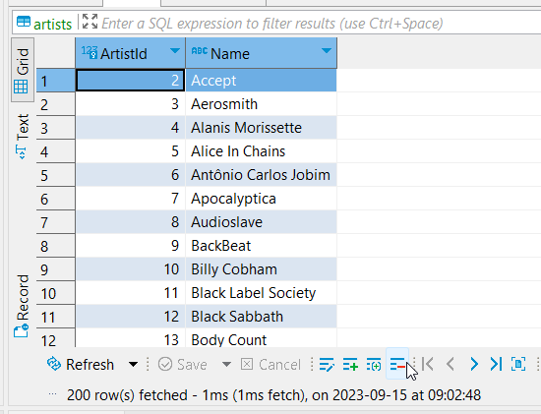

Slide 42
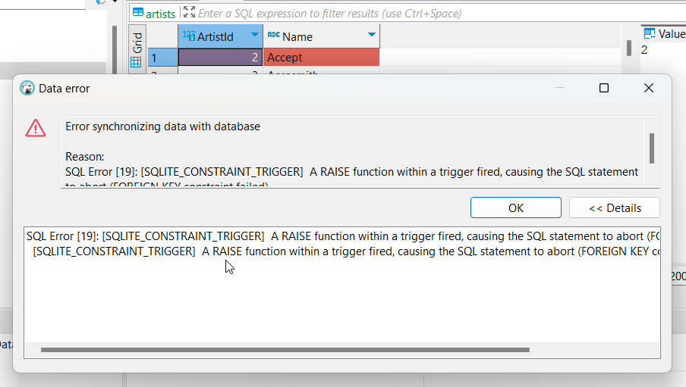

Slide 43
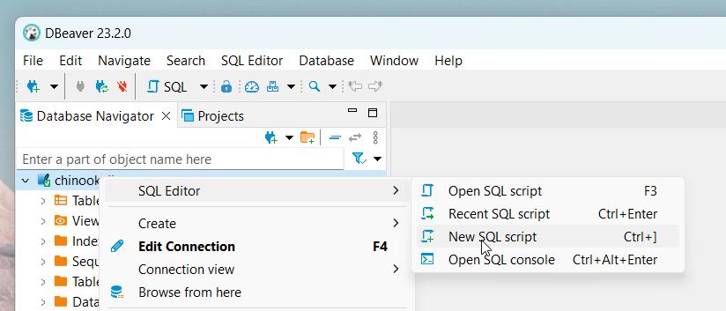

Slide 44
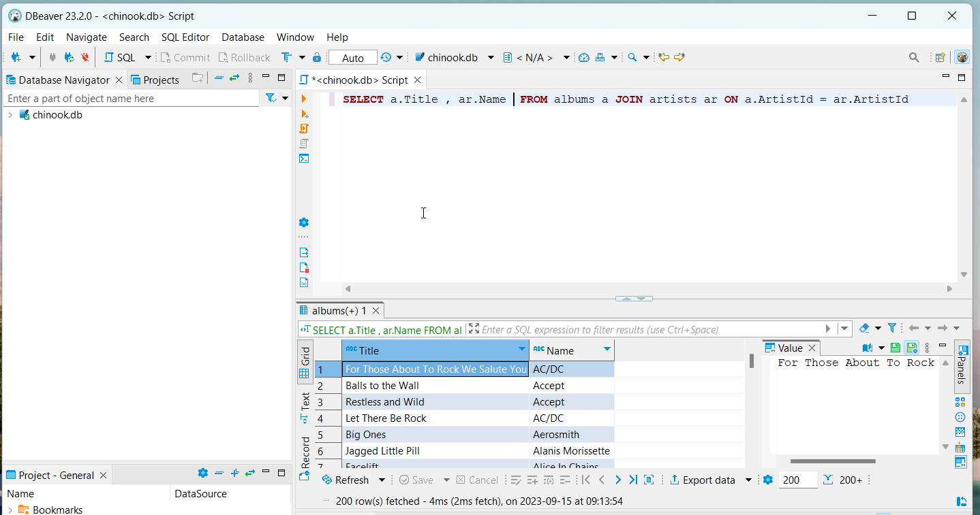

Slide 45
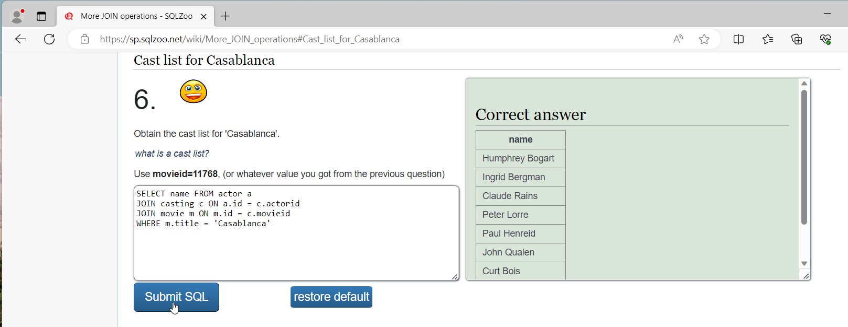
SQLZoo https://sp.sqlzoo.net/wiki/SQL_Tutorial

Slide 46
